Slide 1
Virtual Reality Coding Meet
3 May 2020

Slide 2
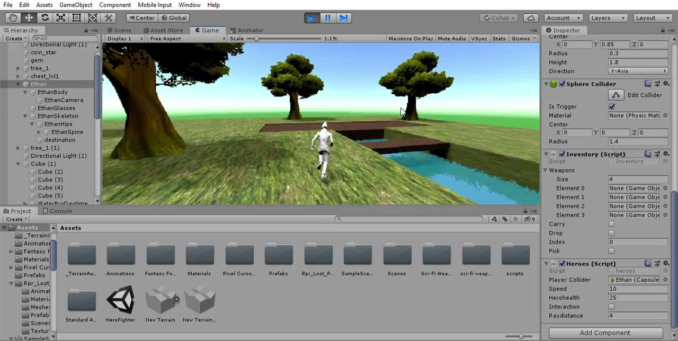
Player Movement (Mumuksh)
Player Movement includes movement of player using Arrow Keys, jumping using Space Bar, crouching using C Key, etc.

Slide 3
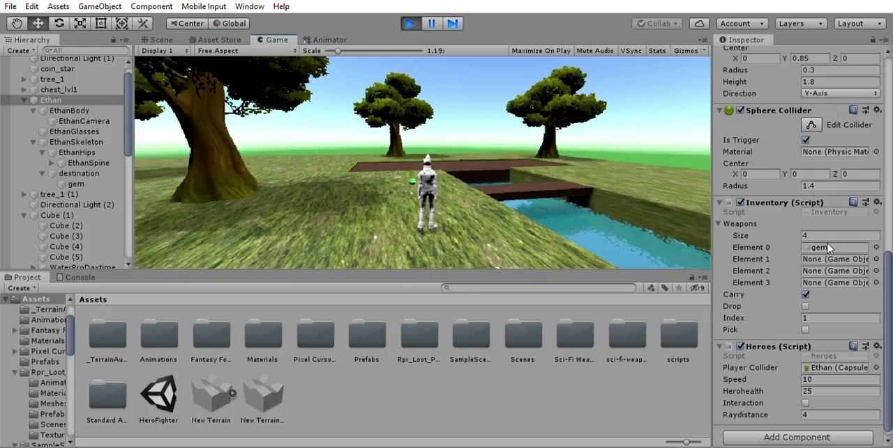
Inventory - Weapon Parts (Mumuksh)
Player Inventory is a place where any pickable object present near the player can be picked and stored in it. The pickable objects can be picked and stored in inventory by simply going near it and pressing O Key. While if the player wants to drop any object from the inventory then this can be done by pressing M Key. The player can traverse through the inventory by scroll wheel.

Slide 4
Enemy Movement and Interaction with environment (Sargun)

Slide 5
Sargun: Learning till now

Slide 7
Sargun: work for next week
Complete 1st course by Wednesday/Thursday
Begin enemy interaction using the free assets available on Asset Store.
Begin 2nd course

Slide 8
User Interface (UI) (Mukesh And Pradhit)

Slide 9
Mukesh :Objective for next week
1.complete the unity ui fundamentals course
2.complete the first course

Slide 10
Virtual Reality Coding Meet
10 May 2020

Slide 11
Work done this week
Learning UI (Mumuksh)
Learning Lighting Visual Effects (Mumuksh)
Enemy Movement (Sargun)
Health bar(Mukesh and Arpit)

Slide 12

Mumuksh work till now (UI learning)
In this video, I have implemented a small bit of what I have learnt in UI.

Slide 13
Mumuksh (Lighting and Visual Effects)
Lighting is majorly of 2 types, one is static lights and other is dynamic lights. Static lights are those which are baked before the game starts running eg. lighting of environment while dynamic lights are those which will change their character while in-game eg. light coming from tube lights can be turned on/off.
Visual Effects is an important thing along with lighting. It defines how an object will appear visually for eg. shinny, emissive, etc.

Slide 14
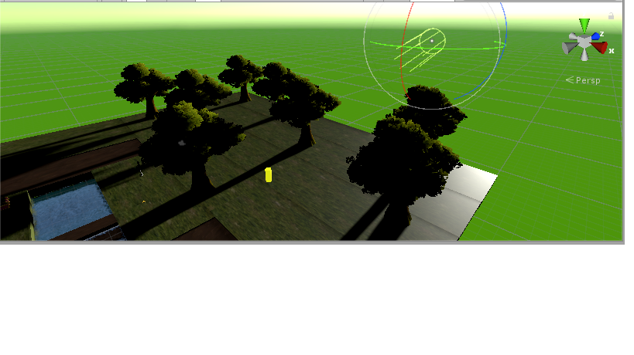
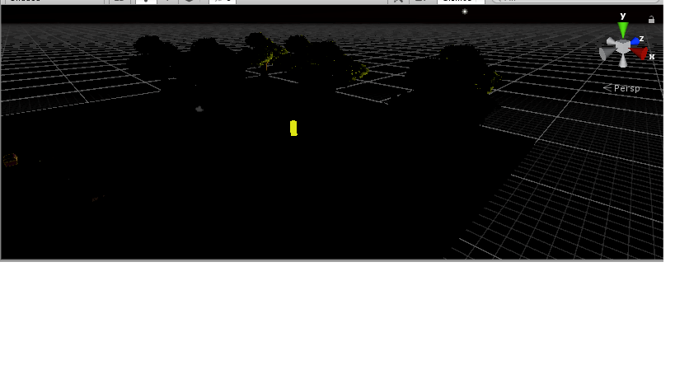
Need of Lighting and Visual Effects
For changing Environments(Day/ Night)
In a scene where you don’t want the things to be much clear to the player then in that cases the lights need to be dull.
Visual Effects eg. Gold object glowing both in day as well as in night.
With Lighting
Without Lighting

Slide 15
Sargun work till now- Enemy motion
Course completed with implementation till first module of Animation.
Made a basic model of the enemy movements. After this I will be using raycasting and health parameter for the player to make use of a kind of shooting interaction.

Slide 16
Enemy interaction (Video)

Slide 17
Mukesh work till now
1.Completed the given course of the unity UI fundamentals which includes the basic Input triggers and anchors and groups and various other ui elements texts, images ,toggles , sliders,scroll menu and drop-down menu.
2. Completed the unity C# scripting fundamentals course important part of which was basic game object interaction and manipulation

Slide 18
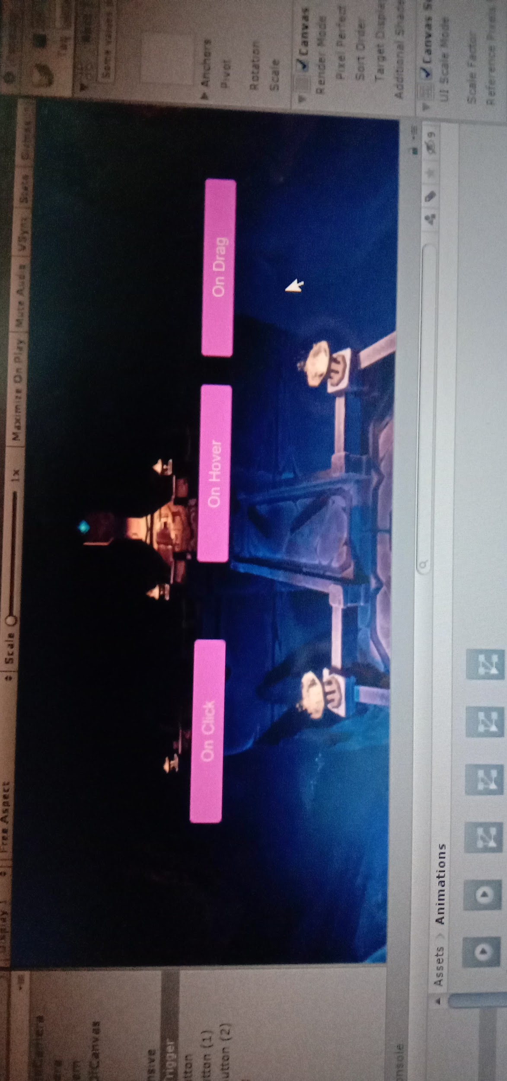
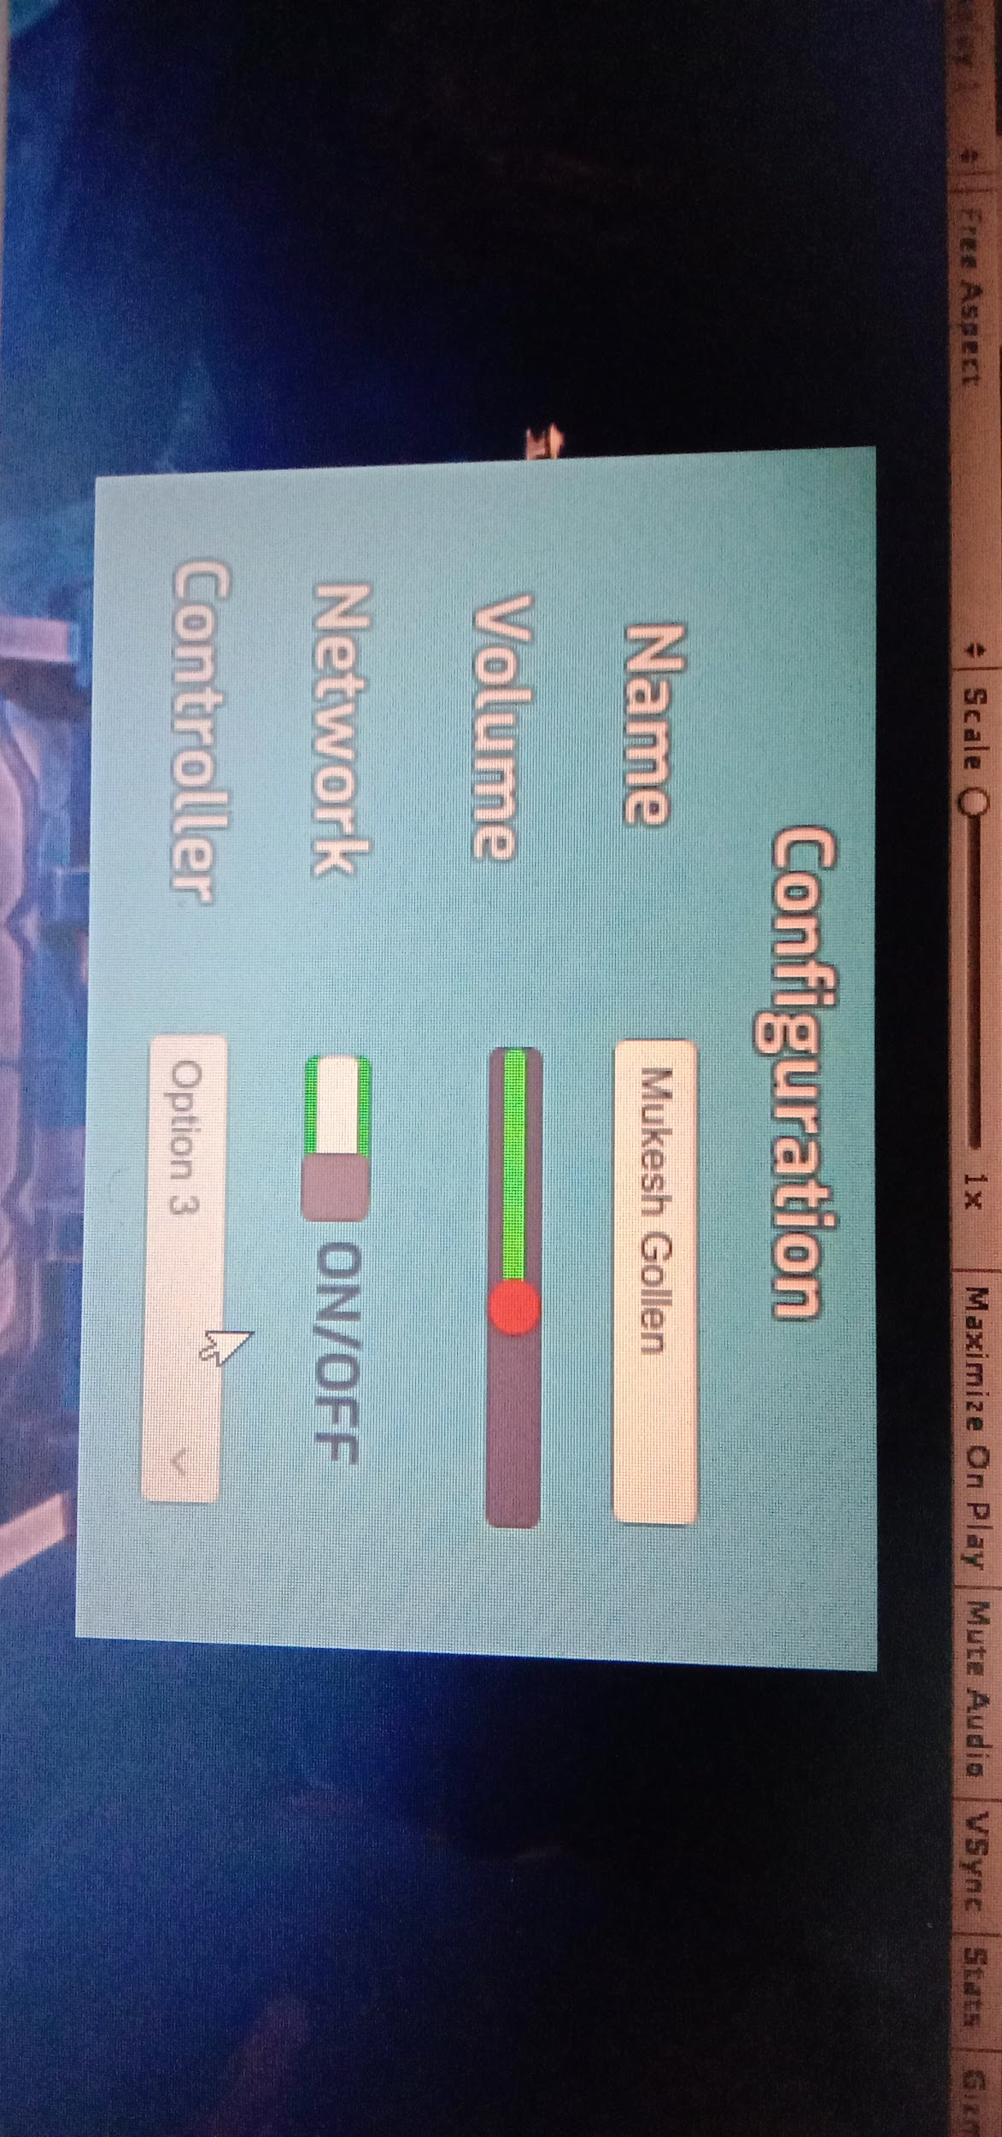
Some work done in user interface

Slide 20
Target of next week
Assembly & Arrangement of House (Mumuksh)
Enemy Movement Improvement(Sargun)
Inventory UI(Mukesh & Arpit)
Health Bar UI(Mukesh & Arpit)
Weapon Assembly(Mumuksh)

Slide 21
Virtual Reality Coding Meet
17 May 2020

Slide 22
Mumuksh work done this week
(House Arrangement - Ground Floor)

Slide 23
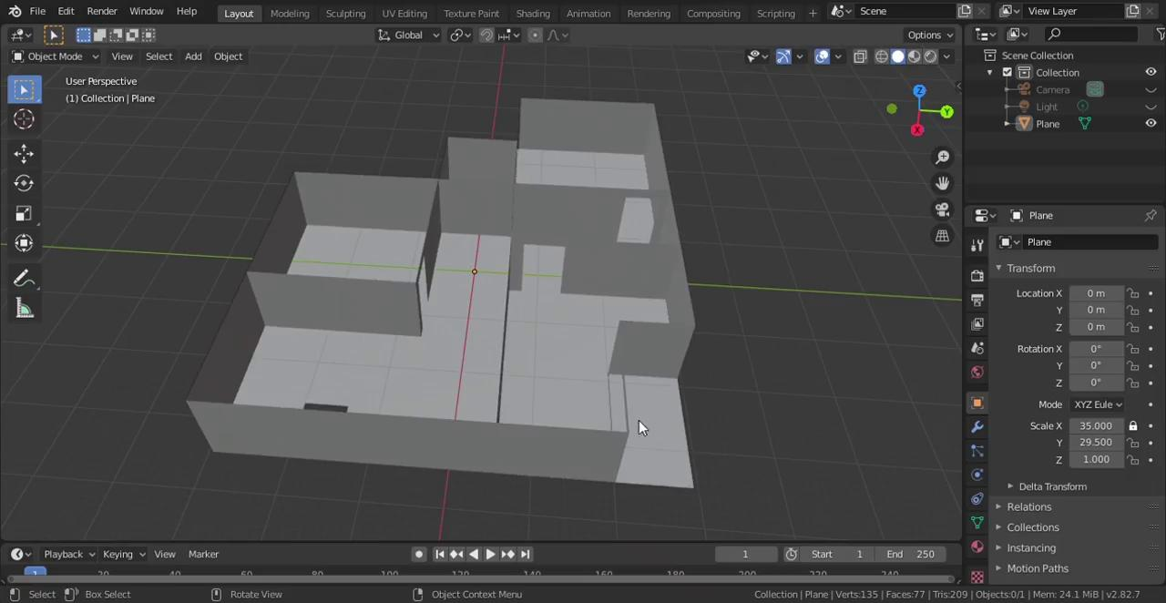
Mumuksh work done this week
(House Arrangement - First Floor)

Slide 24
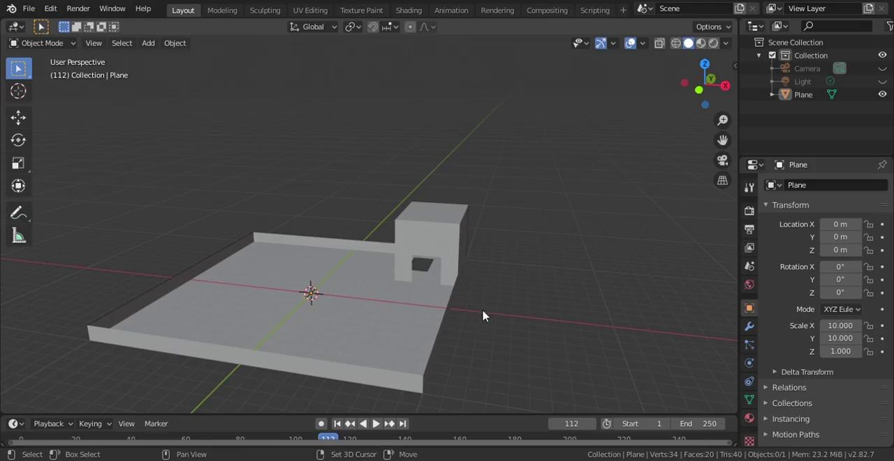
Mumuksh work done this week
(House Arrangement - Terrace)

Slide 25
Mukesh work done this week
Completed the health bar of the player in which health reduces when we press
Space bar .moreover we can add an enemy and then reduce the health by colliding and I will today add the colour gradient and the enemy collider .
Also me and Arpit we started the work of the inventory but we are facing certain difficulies in starting the given scene we will look at today and complete the inventory section by tomorrow positively.

Slide 26
Arpit Work till now
Made a basic Enemy-Player interaction on which enemy attacks the player due to which health of player get reduced which can be seen by Health Bar which changes colour according to the health level(green for more than 60% and red for rest).
Added an health potion which on interaction with the player increases its health.

Slide 27
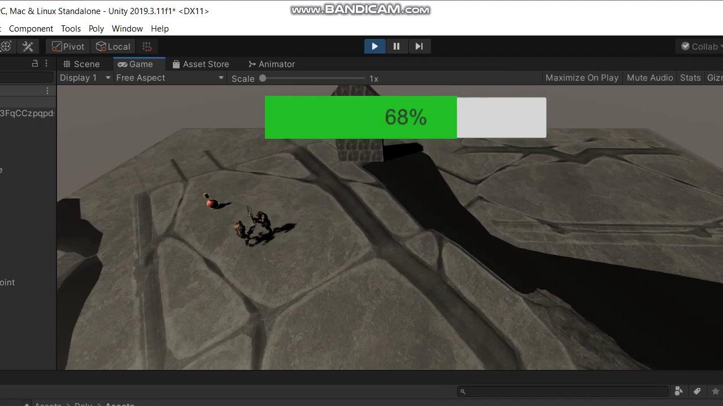
Some work done till now-

Slide 28
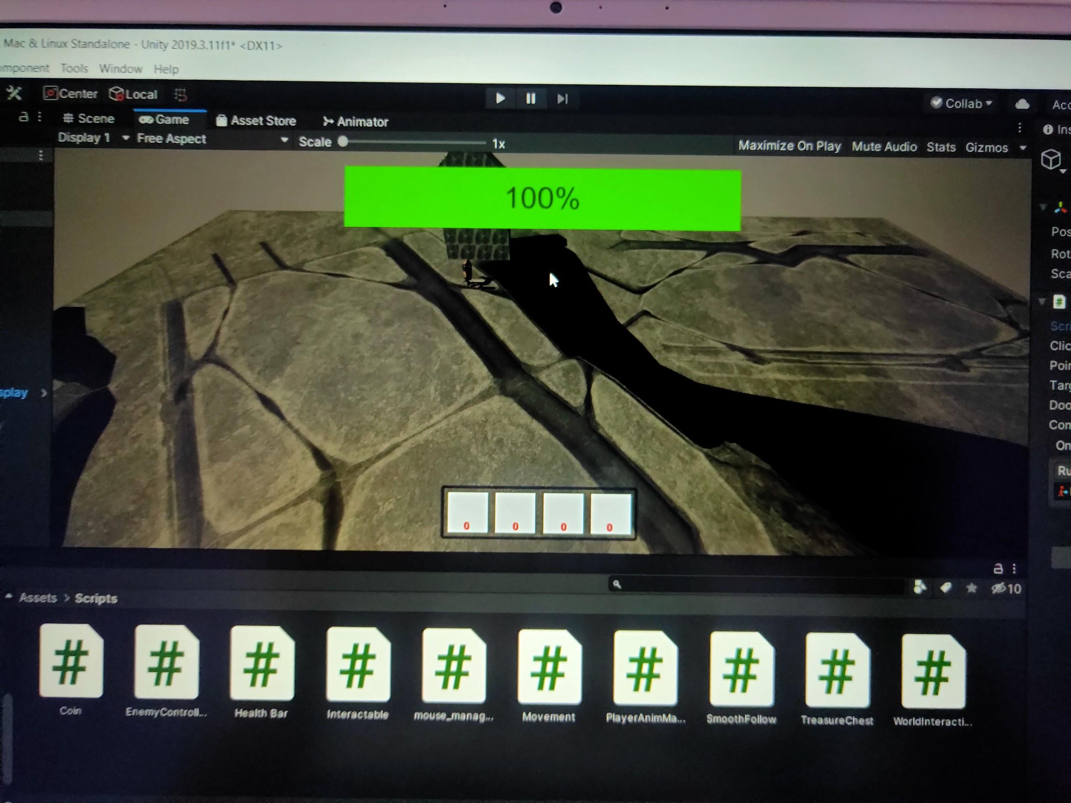

Slide 29
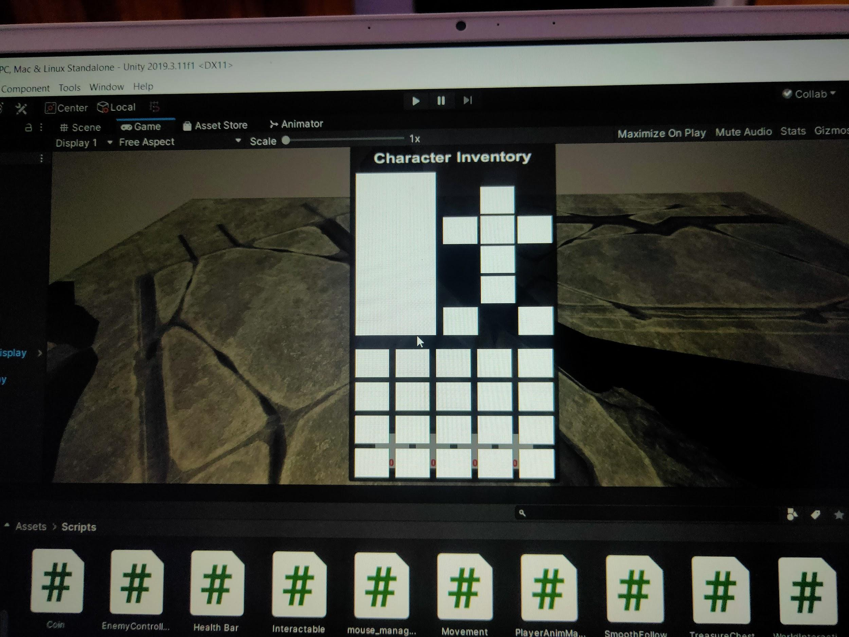

Slide 30
Target for next week
Arrangement of assets in the House (Mumuksh)
Player Customization (Mumuksh)
Enemy Interaction (Sargun)
Main Menu and other UI things (Mukesh & Arpit)

Slide 31
Virtual Reality Coding Meet
24 May 2020

Slide 32
Mumuksh Work done this week (Player Customisation)

Slide 33
Sargun Work done this week
I restarted work on Friday. I mainly worked on setting up the environment. Now I’ve started to implement my model to the environment. Worked with box colliders, rigidbody etc. Currently hard coded how the enemy can’t detect the player in another room. Will generalize that soon.

Slide 34
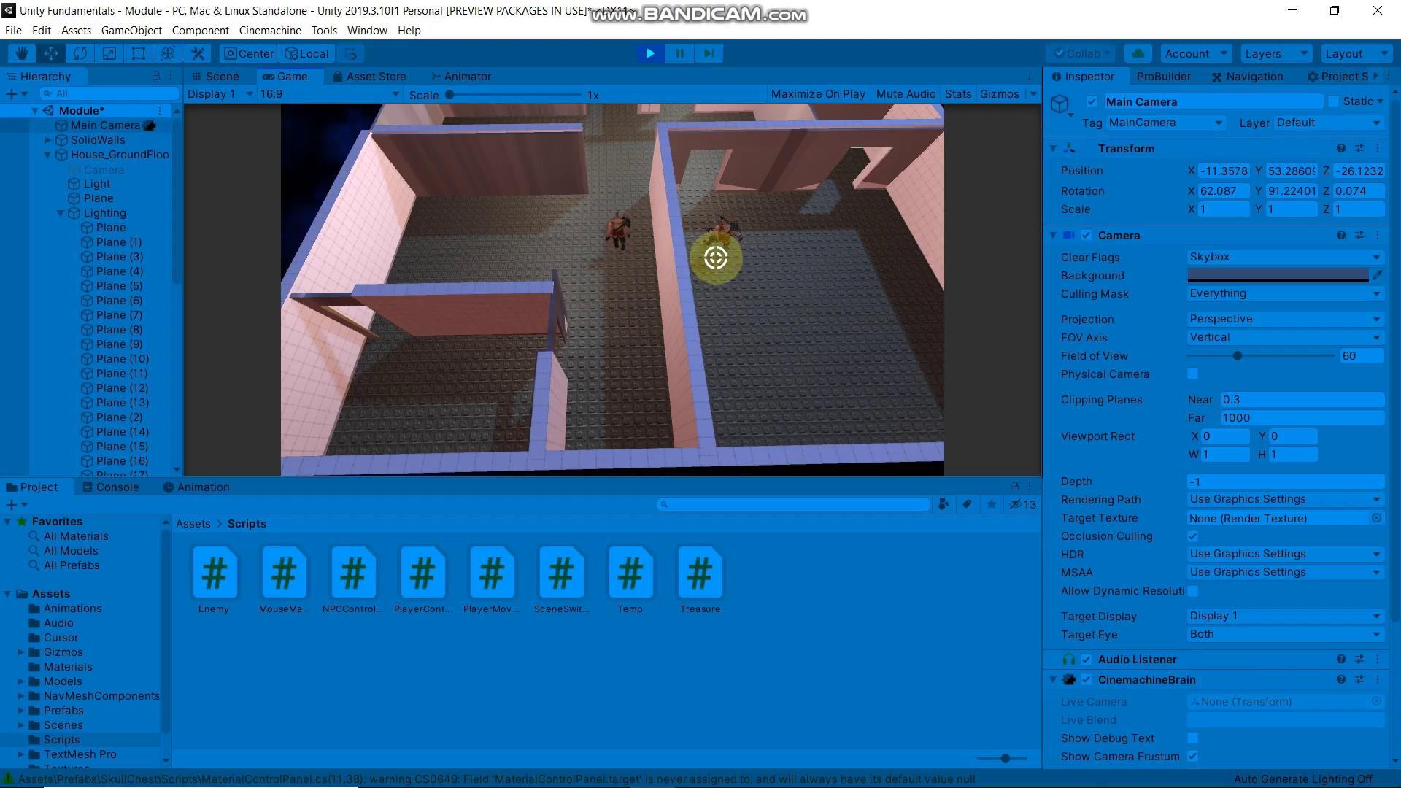

Slide 36
Mukesh Work done this week

Slide 37
Inventory

Slide 39
Sargun: Work Done
Almost done with enemy interactions. Just need to take of minor details and try new things. This week, I worked mainly on improving my Field of View detection system.

Slide 40
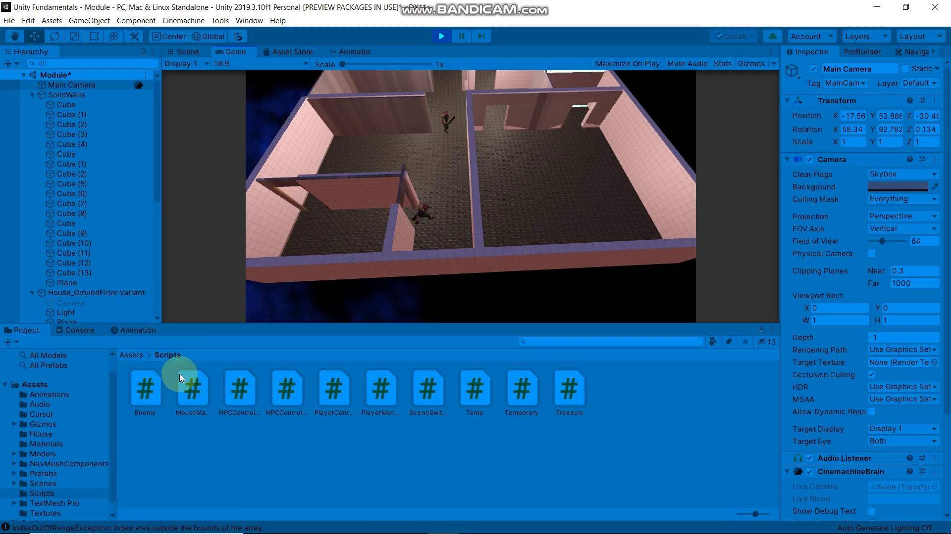

Slide 41
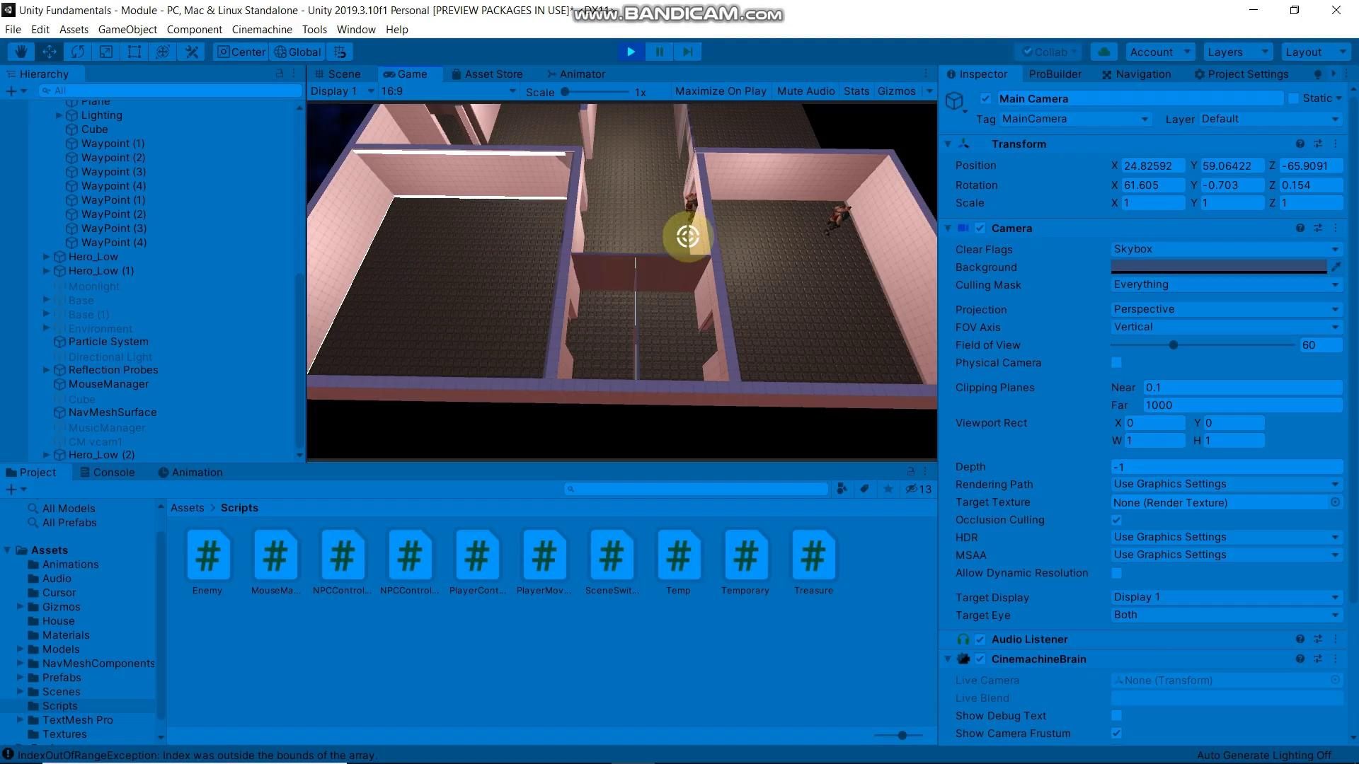

Slide 42
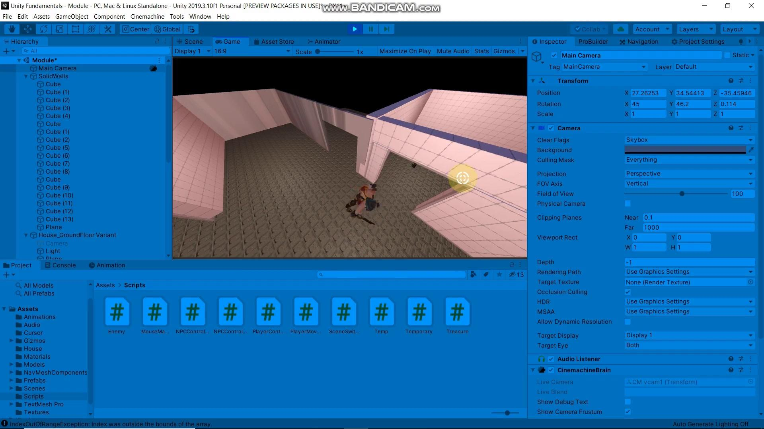

Slide 43
Thank You

Slide 44
Virtual Reality Coding Meet
05 May 2020

Slide 45
Arpit’s work on Lift Controls

